Slide 1
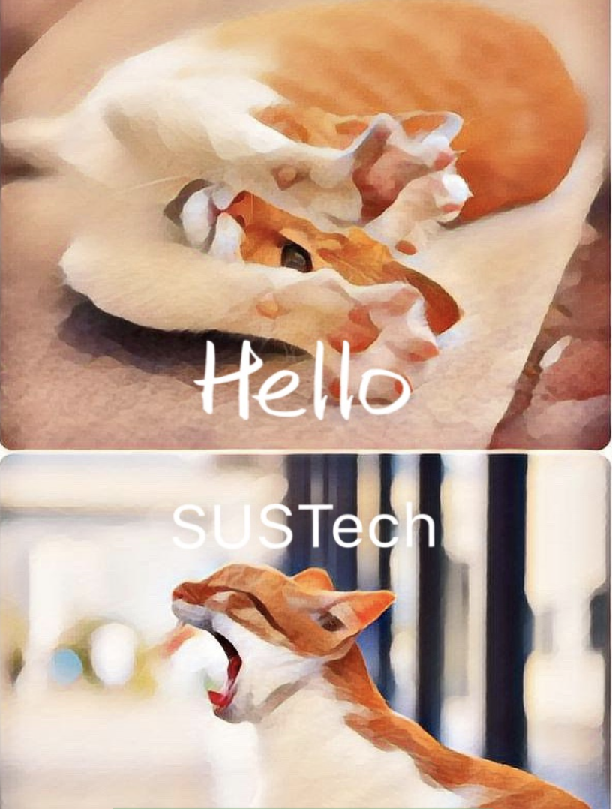
Hello Sustech
11611308 张兆旭，11611808 王雨童，11611326 伍凯明，11611209 徐逸飞，11612232 黄旭

Slide 2
role
11611308 张兆旭 Leader, Developer, Tester
11611808 王雨童 Designer, Tester
11611326 伍凯明 Developer, Document
11611209 徐逸飞 Developer, Designer, Document
11612232 黄旭 Developer, Document

Slide 3
What is Hello sustech?
A SUSTecher’s Assistant
Sign in/up with SUSTech email
Create class table
Check school calendar
A SUSTecher’s Navigator
Check school map
Take a photo
View building picture
Search building by name/image
Navigate to a location

Slide 4
Current progress
Main Page, Welcome Page
Sign in, Sign up
Check School Calendar

Slide 5
Design
Welcome Page:
Show the beauty of SUSTech
Main Page:
Google Design

Slide 6
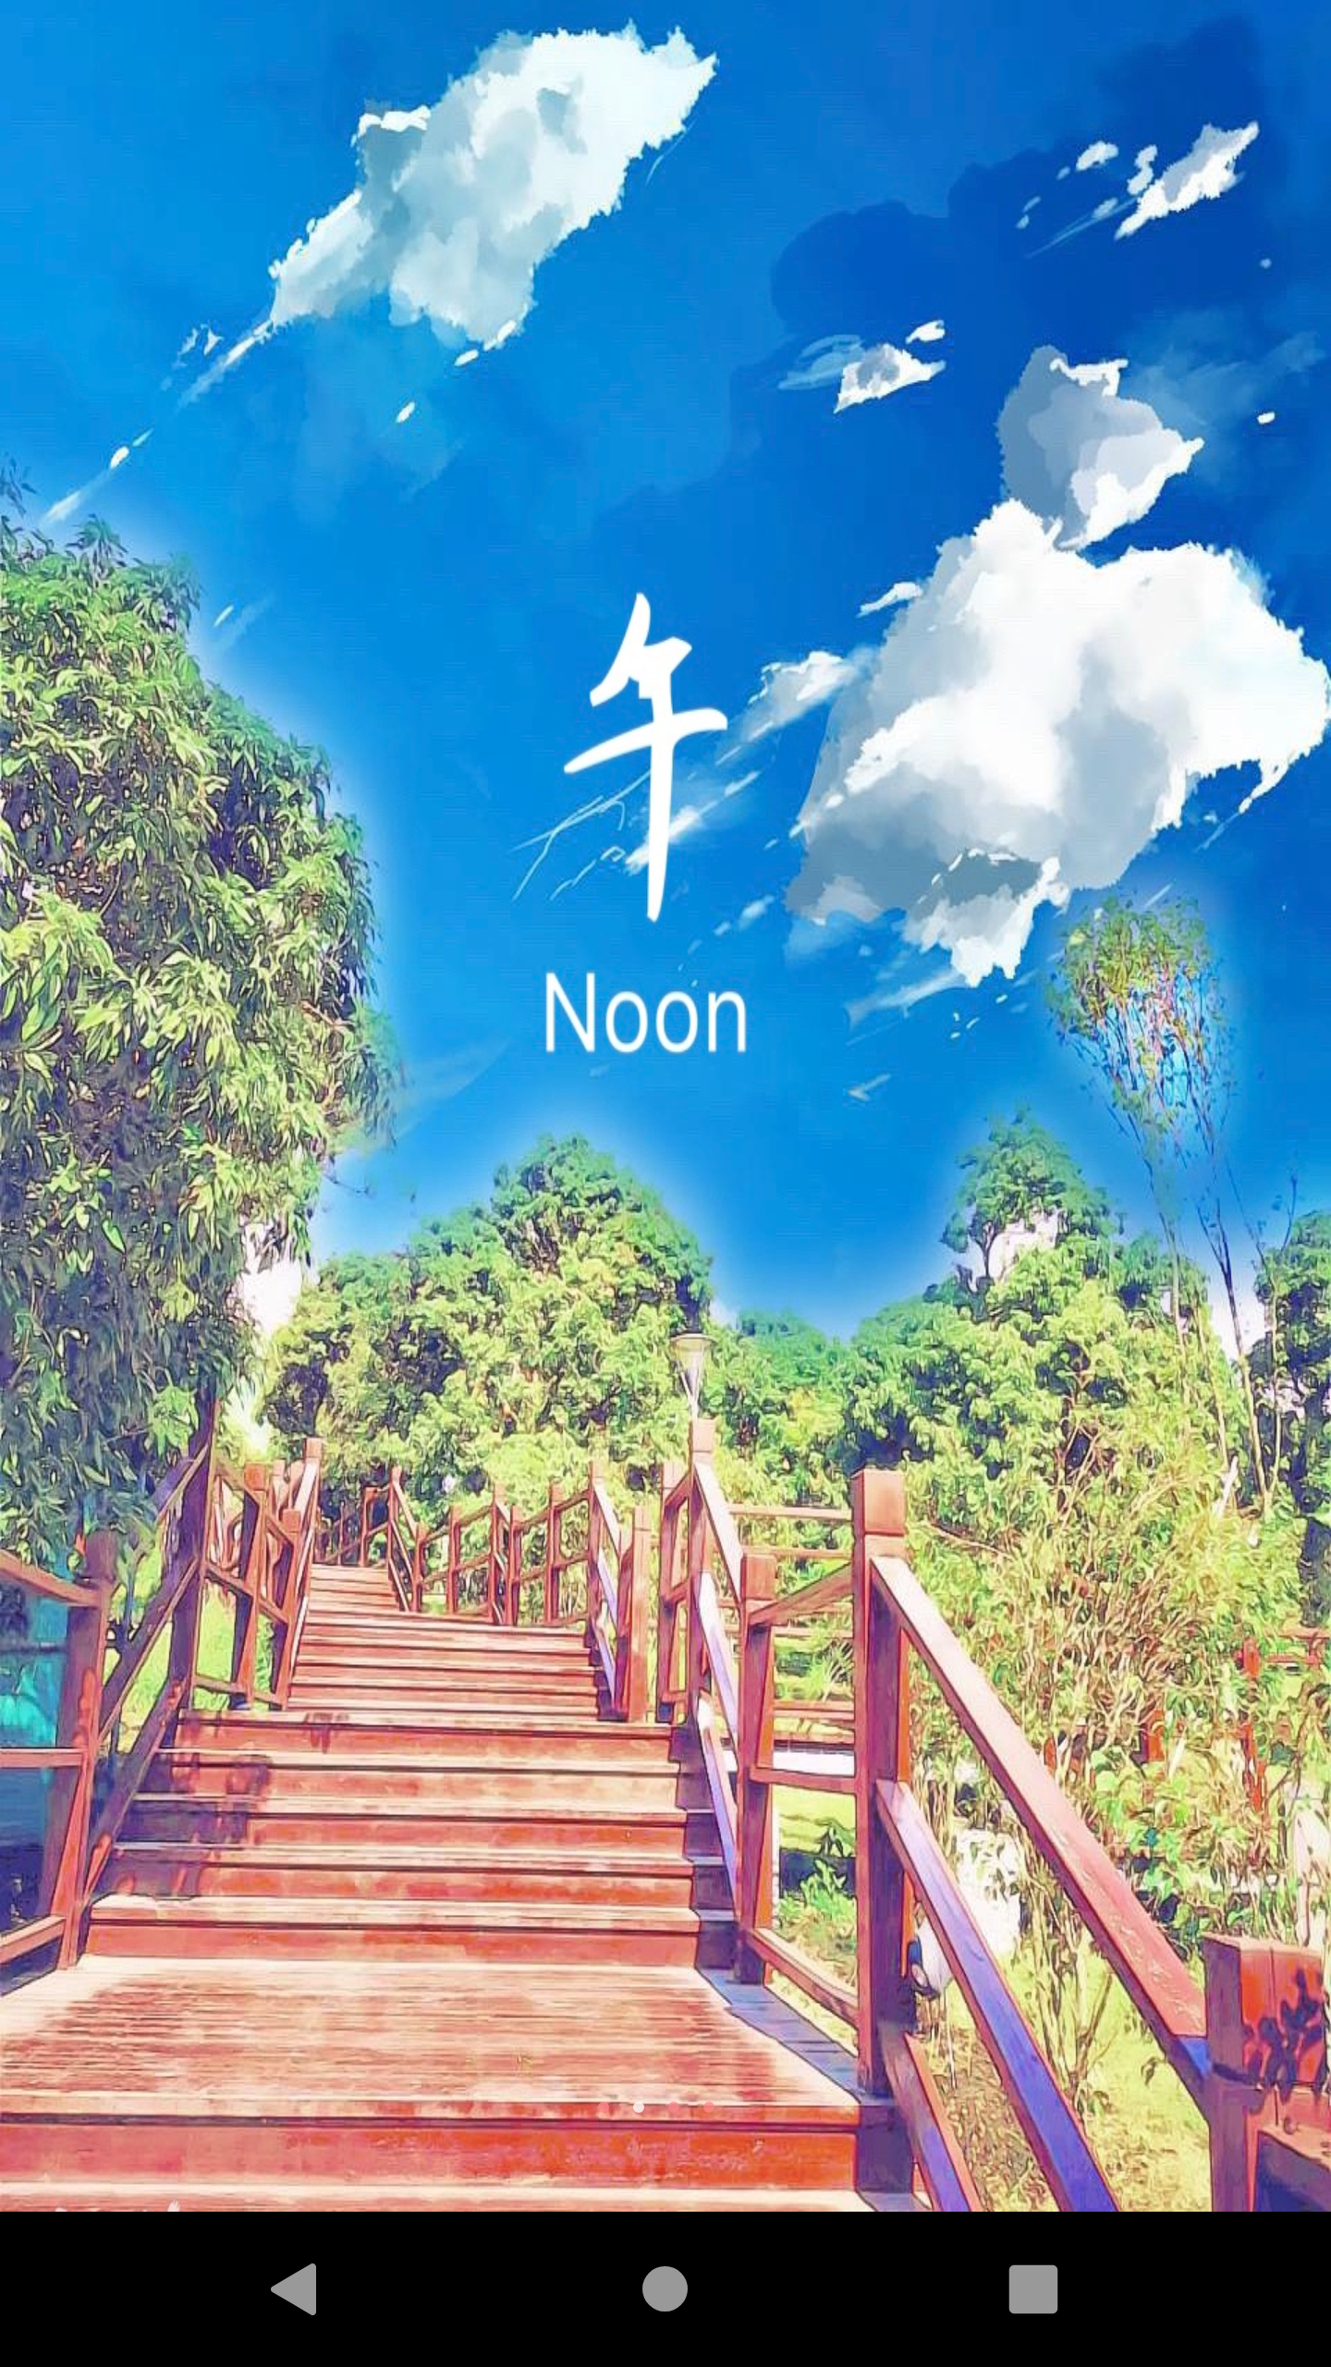
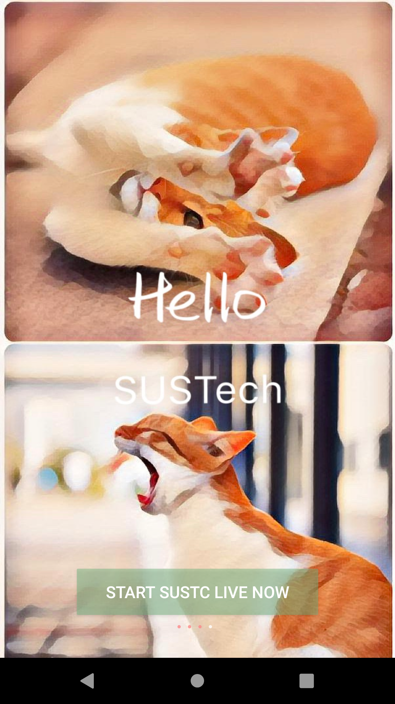
Design

Slide 7
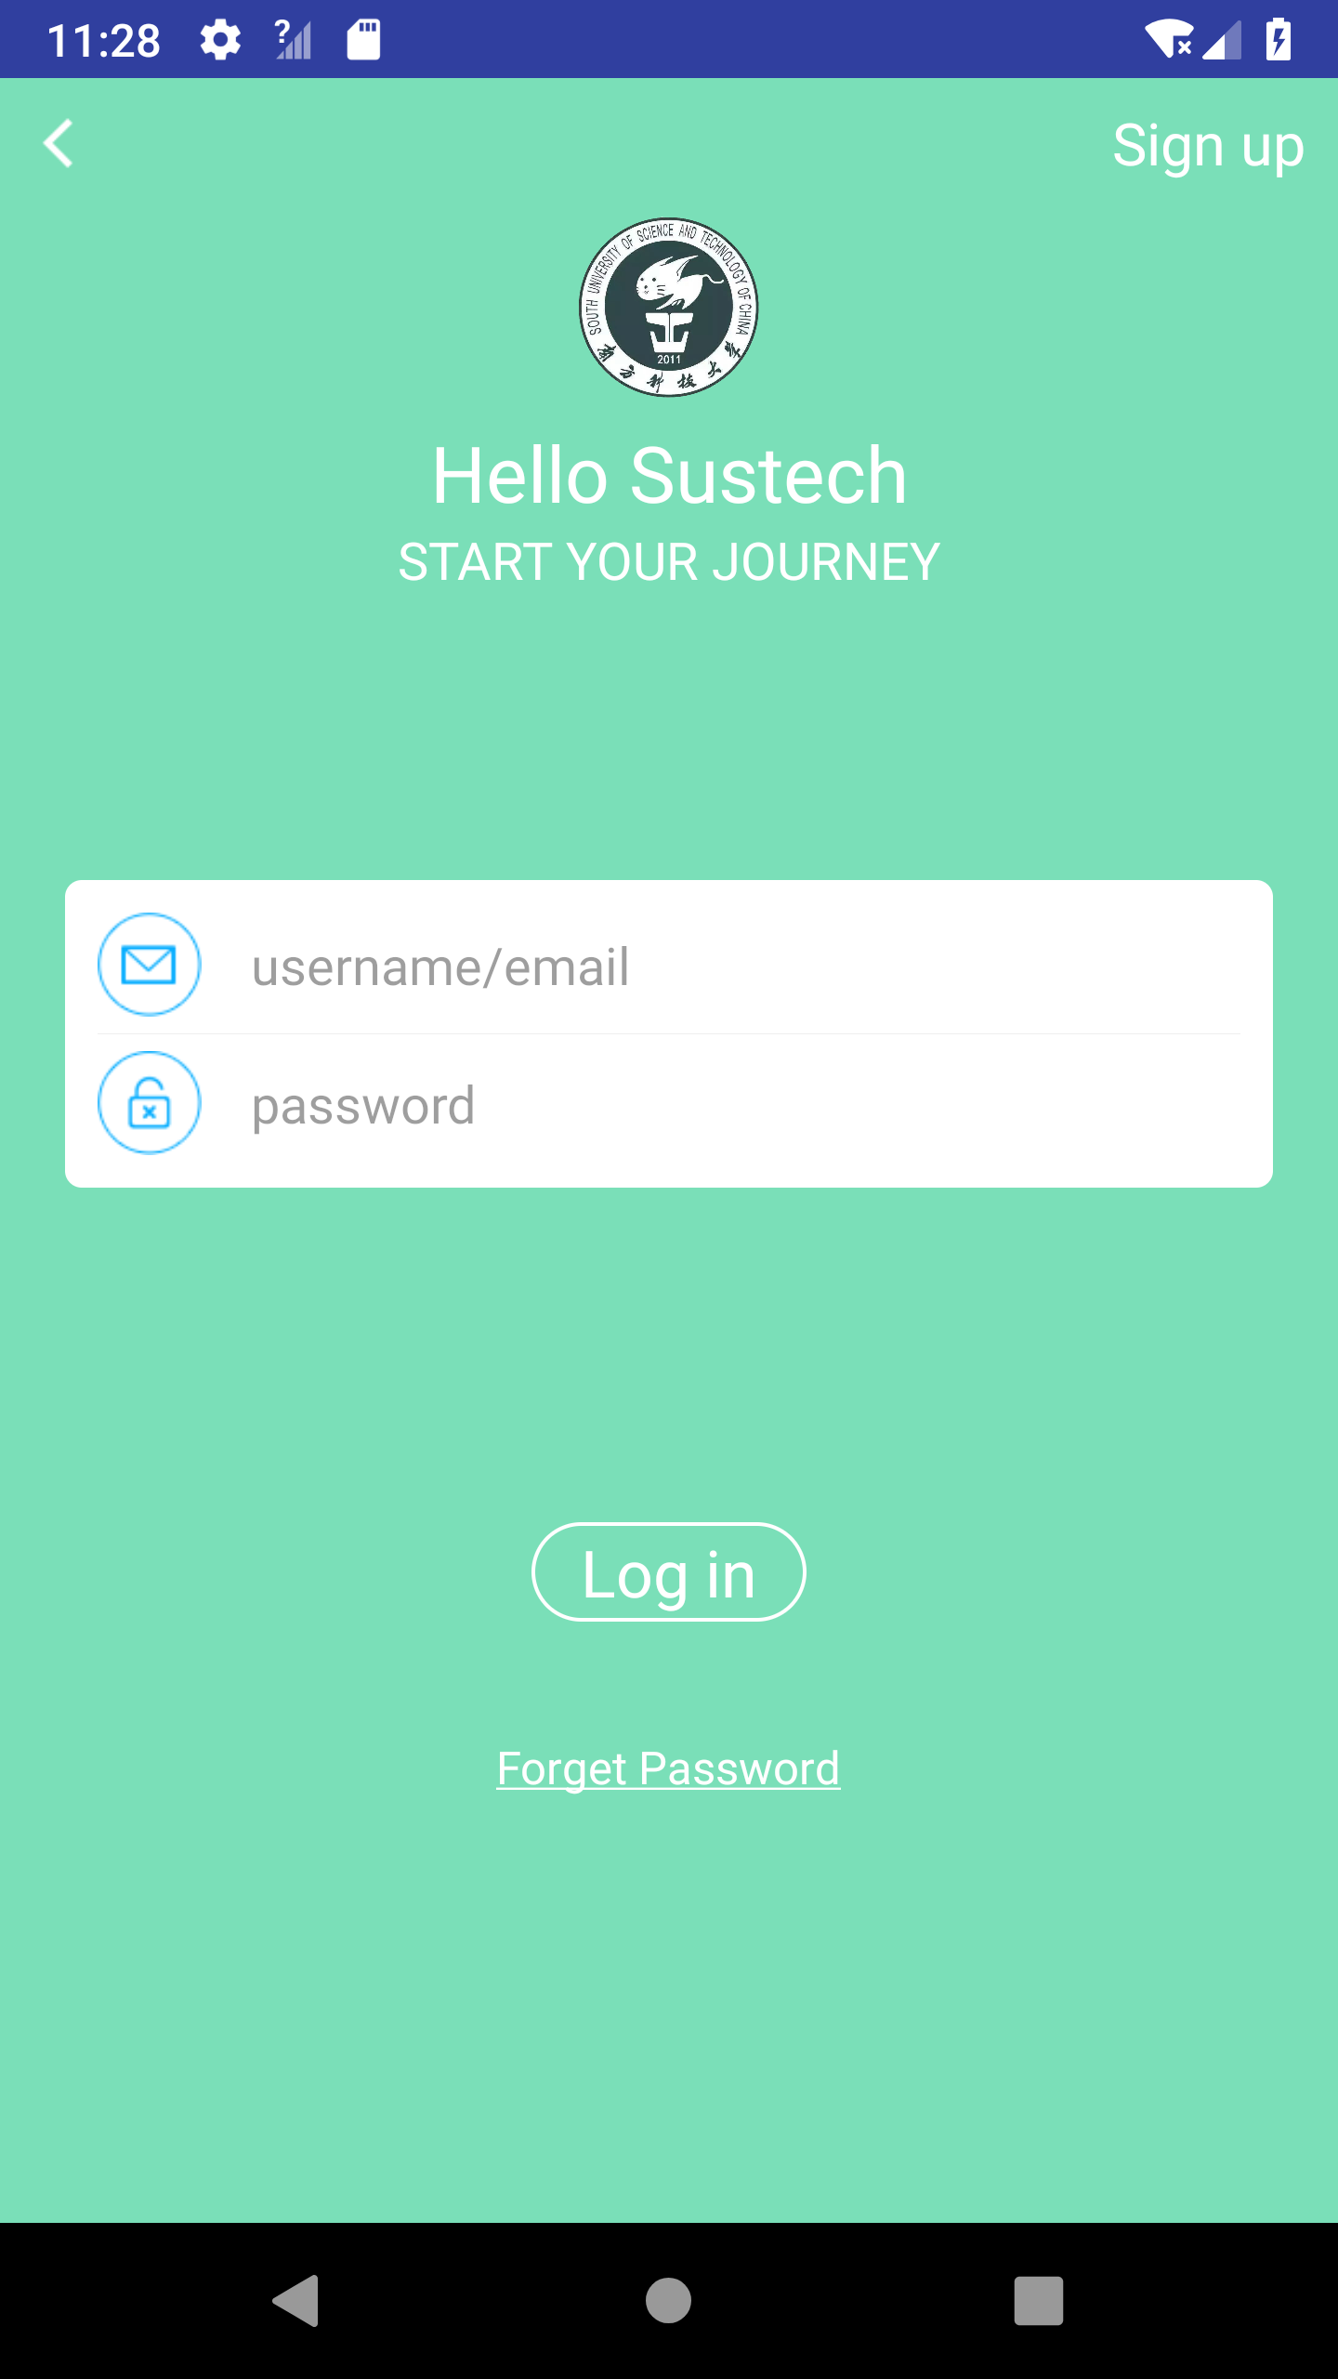
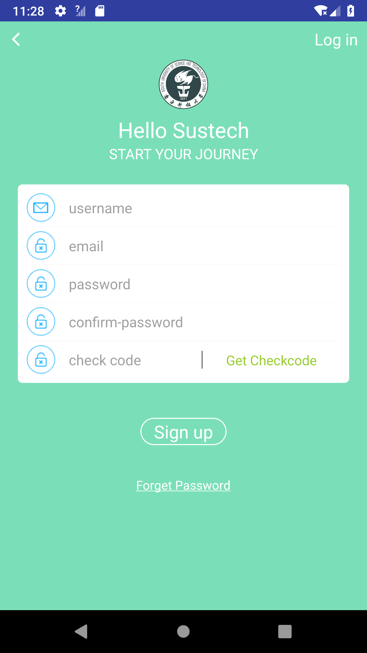
Design

Slide 8
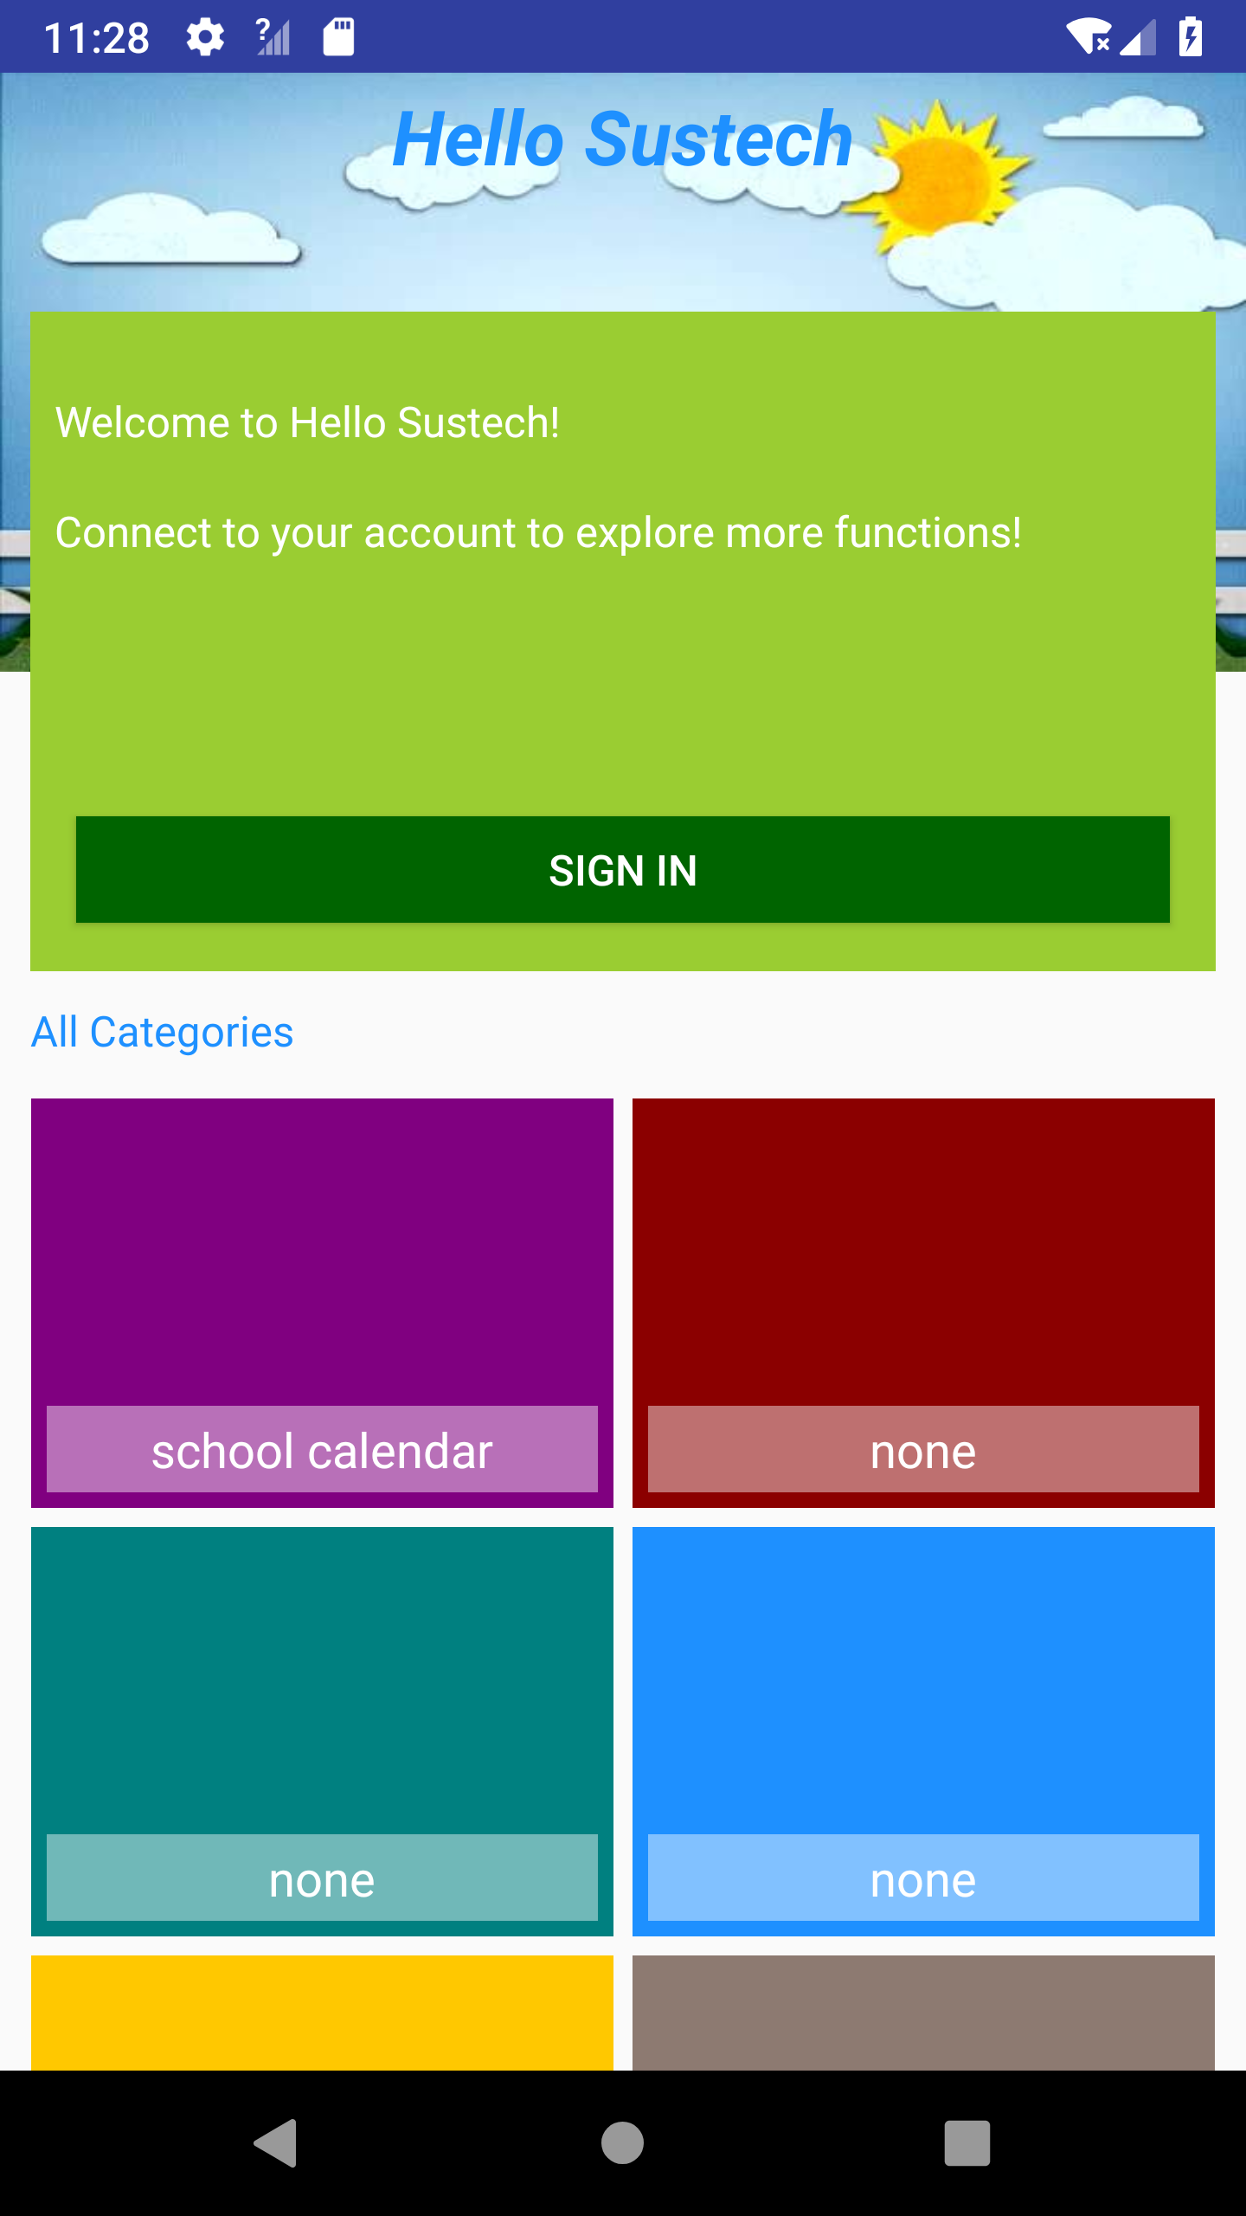
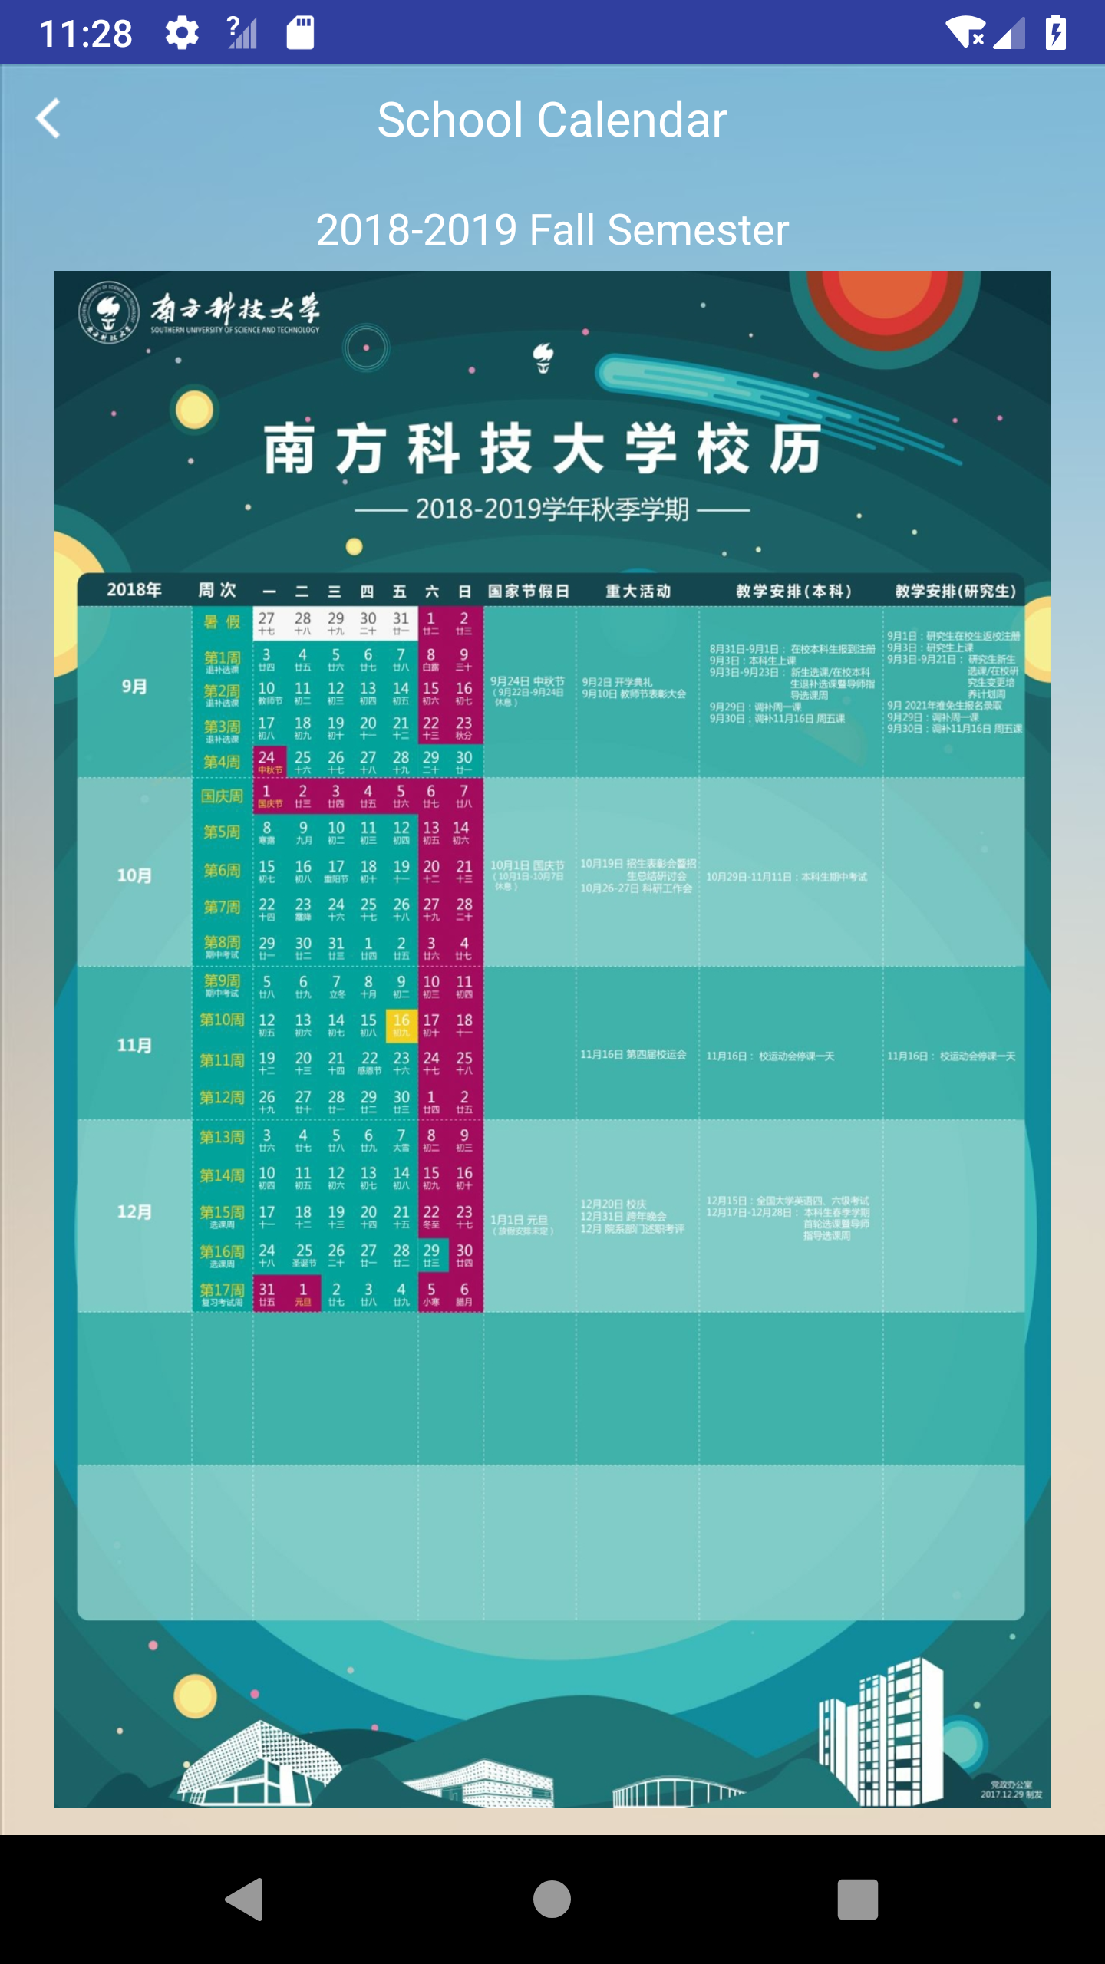
Design

Slide 9
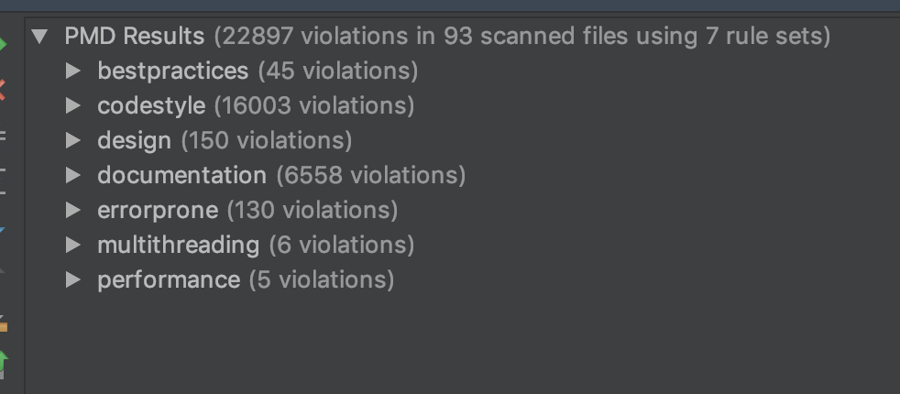
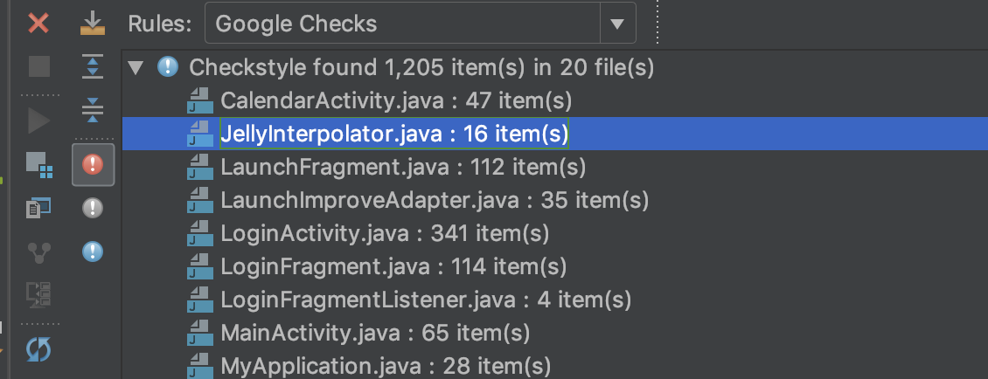
STATic test tools
PMD
CheckStyle

Slide 10
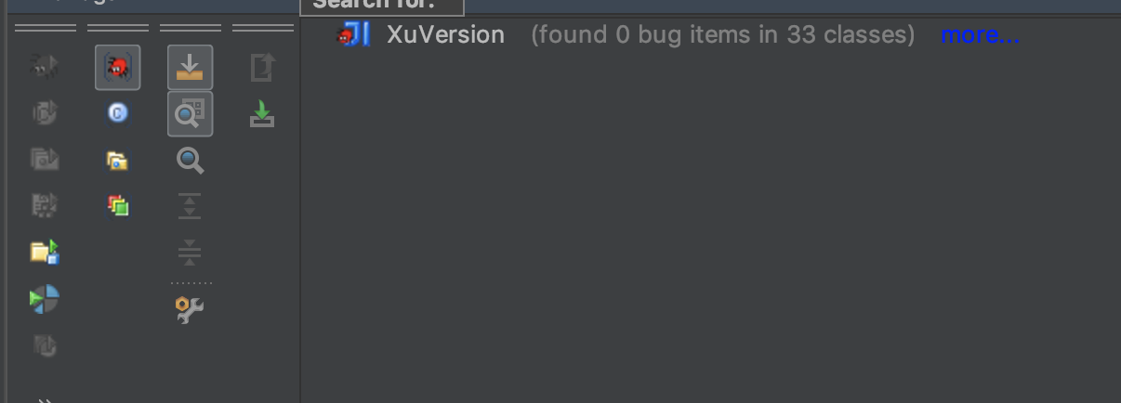
STATic test tools
FindBugs

Slide 11
development

Slide 12
document

Slide 13
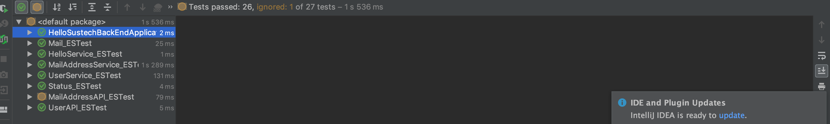
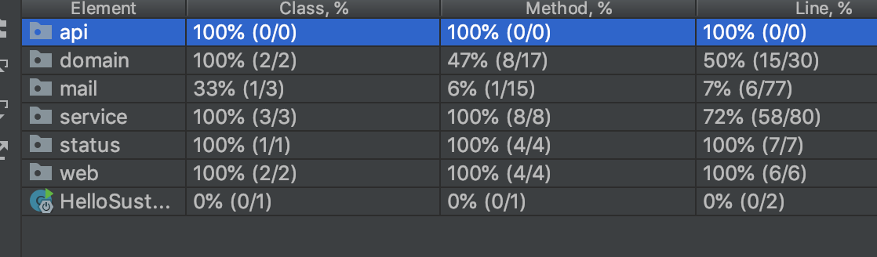
test
Front end:
Espresso for UI test
Back end:
Evosuite

Slide 14
future plan
week | Content
week 10 | Create your owns class table;
week 11 | Look at the school map;Search school buildings by name;
week 12 | Navigate to a location;
week 13 | View pictures of a building;
week 14 | Taking pictures using a camera;
week 15 | Search school buildings by picture

